Slide 1

EXECUTIVE REPORT
BukaToko Funnel
Conversion Analysis
Q2 2025 user activity across countries and channels, and where the purchase funnel leaks conversion.
Nick Wisely
Data Modeling Analyst, Kredivo Group https://www.linkedin.com/in/nickwisely/
September 2026

Slide 2
EXECUTIVE REPORT | BUKATOKO FUNNEL CONVERSION
Summary
ID
Top market, Q2 2025 (1,055 users)
1,223
September MAU pace vs 938 actual
50%
Android share; device-neutral funnel
1.6% → 0.1%
of add-to-carts have same-day activity from search.
KEY FINDINGS
Market — Indonesia is the biggest base: 1,055 active users in Q2 2025, 29% above the US and 2x Vietnam. Run conversion tests there first, with the US as control.
Volume — MAU is flat at roughly 1.1-1.3k; September's 938 covers only 23 of 30 days, a ~1,223 full-month pace, so concentrate promo spend in that window.
Device — Android holds 50% of 9,761 sessions, iOS 40%, desktop 10%, yet purchase is the last event for only 4-5% on every device: the funnel is device-neutral.
Geography x device — the mix barely changes by country, so one Android-first release train is enough; a phone-sized UI reused on desktop is the likely quality gap.
Momentum — only 1.6% of add-to-carts (16 of 970) follow same-day activity and search drives just 1 of them (0.1% or 6.3% of all same day); create same-day momentum with time-boxed flash sales.
Funnel Analysis | Browse -> Cart -> Checkout -> Purchase
01/09

Slide 3
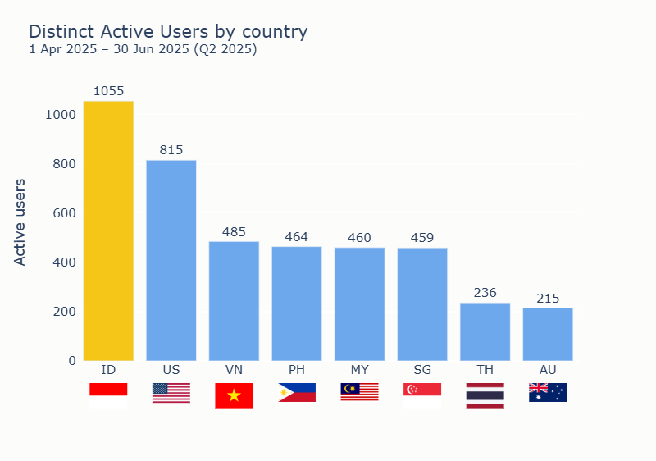
EXECUTIVE REPORT | BUKATOKO FUNNEL CONVERSION
Question 1 -- Active Users by Country (Q2 2025)
REMARKS
Reading the chart: Indonesia leads Q2 2025 with 1,055 active users — 29% above the US (815) and more than 2x Vietnam (485). PH, MY and SG cluster near 460; TH and AU trail below 250.
Recommendation: Increase the sales density in Indonesia to generate more revenue. Match with country monthly personal capacity
Funnel Analysis | Browse -> Cart -> Checkout -> Purchase
02/09

Slide 4
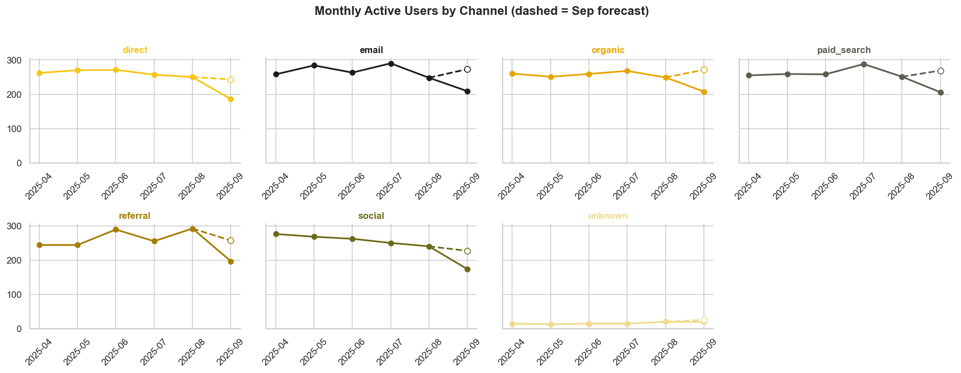
EXECUTIVE REPORT | BUKATOKO FUNNEL CONVERSION
Question 2 -- Monthly Active Users Trend
TOTAL MAU BY MONTH (APR-SEP 2025, SEP IS PARTIAL)
938
September actual MAU (1-23 Sep)
1,223
September forecast (x 30/23, full month) Possible All Tme High
Reading the trend: September's 938 covers only 23 days. Scaled to 30 days it reaches ~1,223 — the strongest month, not a decline.
Recommendation: re-baseline targets on 1,223 and put promo spend in this window; confirm with full-month data.
Funnel Analysis | Browse -> Cart -> Checkout -> Purchase
03/09

Slide 5
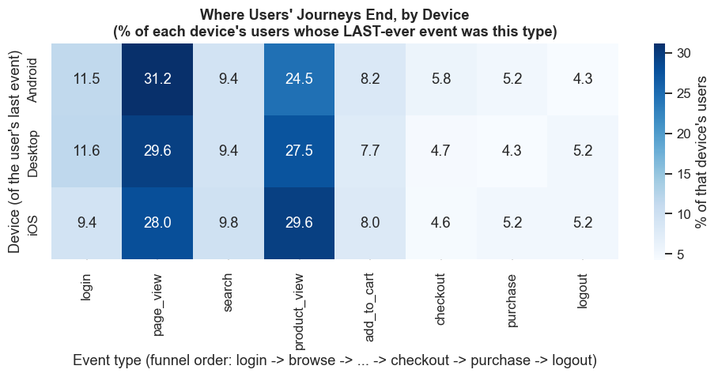
EXECUTIVE REPORT | BUKATOKO FUNNEL CONVERSION
DIY 1 -- Device Usage
SESSIONS BY DEVICE (1 SESSION = 1 EVENT)
WHERE EACH DEVICE'S USERS END (%)
Reading the charts: Android holds 4,837 of 9,761 sessions (50%), iOS 3,903 (40%) and desktop 1,021 (10%) — yet journeys end the same way on all three: page_view and product_view absorb 55-60% of last events and purchase is the last event for only 4-5%. Device is not what decides whether a user completes the funnel.
Possible cause: the UI is sized for a phone. On desktop the same layout leaves wasted width, oversized tap targets and a checkout that never uses the larger screen — which is why desktop gains nothing despite more room.
Recommendation: do not optimise for one device. Fix the funnel steps themselves, and treat a responsive desktop layout as a UI-quality fix rather than a growth bet.
Funnel Analysis | Browse -> Cart -> Checkout -> Purchase
04/09

Slide 6
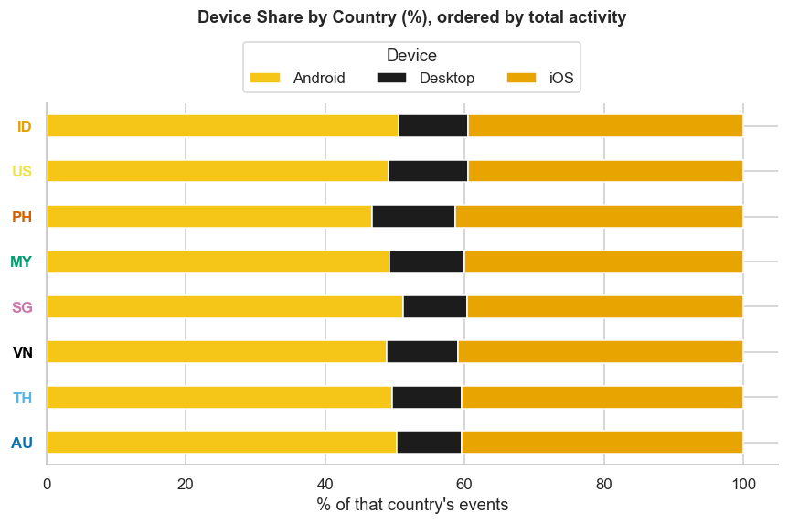
EXECUTIVE REPORT | BUKATOKO FUNNEL CONVERSION
DIY 1b – Device Mix by Country
REMARKS
Reading the chart: Android takes roughly half of events in every market, iOS most of the rest and desktop about 10%. The mix barely moves by country, and device does not change how far a user gets in the funnel.
Possible cause: a phone-sized UI reused on desktop.
Recommendation: one global release train, no per-device or per-country optimisation.
Funnel Analysis | Browse -> Cart -> Checkout -> Purchase
04/09

Slide 7
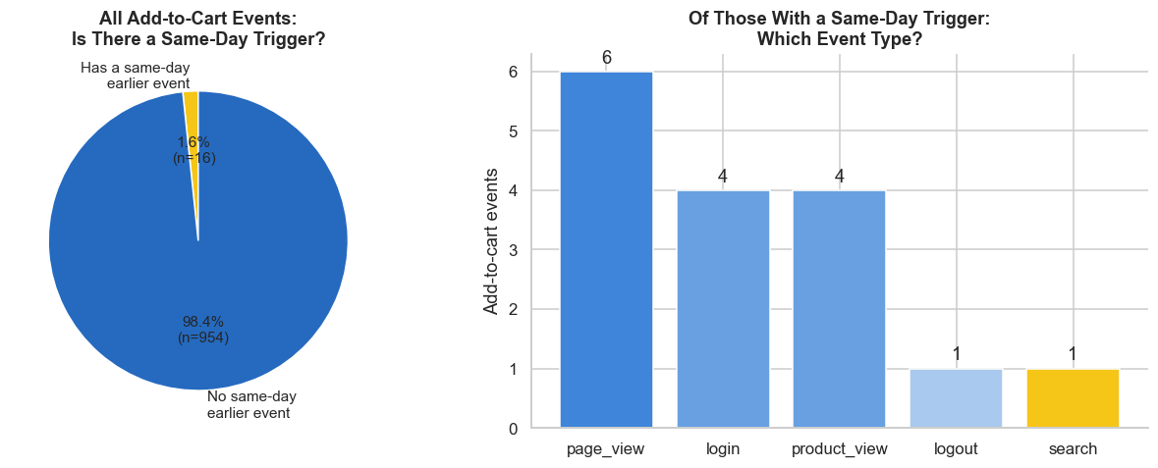
EXECUTIVE REPORT | BUKATOKO FUNNEL CONVERSION
DIY 2 – Same-Day Add-to-Cart Momentum
SAME-DAY MOMENTUM IS RARE — AND SEARCH IS NOT THE STORY
Reading the charts: only 1.6% of add-to-cart events (16 of 970) have earlier same-day activity; 98.4% arrive cold. Of those 16, search triggered just 1 — 6.3% of same-day cases, 0.1% of all add-to-carts.
Recommendation: the issue is not the traffic source but how little happens in one day. Use time-boxed flash sales (6-hour deals, countdown, cart-expiry reminder) to compress browse, cart and checkout into one session.
Funnel Analysis | Browse -> Cart -> Checkout -> Purchase
04/09

Slide 8
EXECUTIVE REPORT | BUKATOKO FUNNEL CONVERSION
Additional Analysis – What We Looked Into
01
Funnel shape
How much of Browse survives to Purchase?
02
Lead time
How long between stages, and which gap is slowest?
03
Demand timing
Which days and hours drive purchases?
04
Cart drop-off
Who adds to cart but never buys?
THE BUSINESS QUESTION
Where exactly do we lose the sale, and what would we have to change to get it back?
These four analyses take the funnel apart step by step: how many users survive each stage, how long they wait in between, when demand actually happens, and where intent is created but never converted.
Each is framed as a decision, not a chart: which step to fix first, when to intervene, and what to stop spending on.
Funnel Analysis | Browse -> Cart -> Checkout -> Purchase
01/09

Slide 9
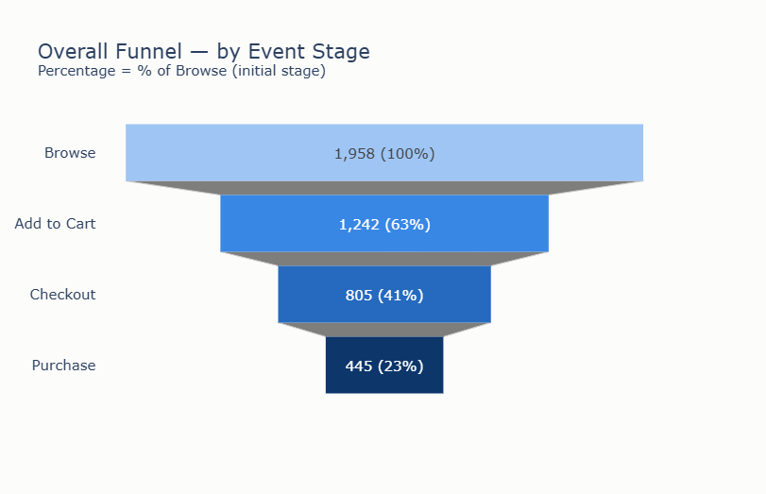
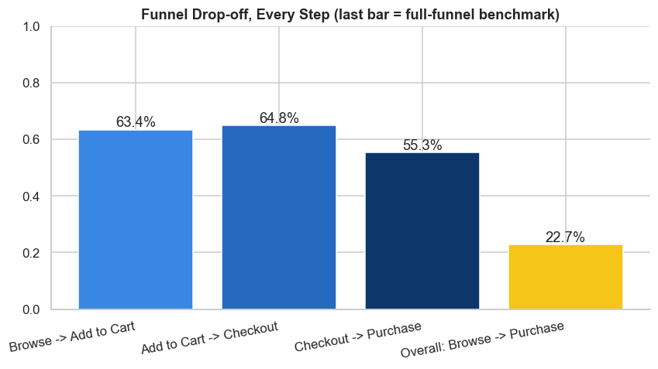
EXECUTIVE REPORT | BUKATOKO FUNNEL CONVERSION
Funnel Conversion Overview
USERS REACHING EACH FUNNEL STAGE
Reading the funnel: 1,958 browse to 1,242 carts (63.4%) to 805 checkouts (64.8%) to 445 purchases. The weakest step is the last: only 55.3% of checkouts become a purchase — 360 users drop after already committing to buy.
Recommendation: diagnose payment, not the catalogue. Is paying easy? Is QRIS offered? Are Virtual Account and e-wallet complete, and do payment timeouts cancel orders? A UX test on checkout with 5-8 real buyers will expose this faster than any dashboard.
Funnel Analysis | Browse -> Cart -> Checkout -> Purchase
05/09

Slide 10
EXECUTIVE REPORT | BUKATOKO FUNNEL CONVERSION
Lead Time per Funnel Stage
AVERAGE LEAD TIME BETWEEN STAGES (DAYS)
Funnel step | Users (n) | Mean (h) | Median (h) | Mean (days)
1. Browse → Add to Cart | 539 | 1,558.1 | 1,418.6 | 64.9
2. Add to Cart → Checkout | 51 | 1,062.5 | 1,063.4 | 44.3
3. Checkout → Purchase | 3 | 391.8 | 505.9 | 16.3
Reading the table: every step averages more than 14 days — 64.9 to Cart, 44.3 to Checkout, 16.3 to Purchase. This is not a shopping session but a months-long process (the last step rests on only 3 cases).
Recommendation: (1) tooling — an ERP or simple internal app so stock, price and order status update in real time; (2) pull customers forward with push notifications at the browse and cart moments plus targeted social campaigns; (3) shorten the flow — cart straight to payment (one-tap buy), no separate checkout step.
Funnel Analysis | Browse -> Cart -> Checkout -> Purchase
06/09

Slide 11
EXECUTIVE REPORT | BUKATOKO FUNNEL CONVERSION
Purchase Timing
PURCHASES BY DAY OF WEEK
PURCHASES BY DAY OF WEEK, BY COUNTRY (% OF THAT COUNTRY'S PURCHASES)
% | Mon | Tue | Wed | Thu | Fri | Sat | Sun
ID | 11.2 | 10.4 | 17.2 | 16.7 | 16.4 | 12.7 | 13.4
US | 12.9 | 11.8 | 16.1 | 10.8 | 10.8 | 16.1 | 21.5
PH | 12.9 | 14.3 | 15.7 | 5.7 | 20.0 | 17.1 | 14.3
MY | 16.4 | 14.5 | 7.3 | 12.7 | 18.2 | 14.5 | 16.4
VN | 9.8 | 5.9 | 11.8 | 15.7 | 31.4 | 13.7 | 13.7
SG | 9.5 | 9.5 | 11.9 | 16.7 | 11.9 | 16.7 | 23.8
TH | 9.4 | 15.6 | 15.6 | 12.5 | 18.8 | 9.4 | 18.8
AU | 4.5 | 9.1 | 27.3 | 13.6 | 22.7 | 13.6 | 9.1
Reading the charts: at group level demand builds towards the weekend — Friday peaks at 88 purchases and Thursday to Sunday carries about 55% of the week, with 06:00 the busiest hour. The country matrix shows that this single peak is an average, not a rule: VN puts 31.4% of its purchases on Friday and AU 27.3% on Wednesday, while US (21.5%) and SG (23.8%) sell most on Sunday and ID simply spreads across Wednesday to Friday.
Why it matters: a single global Friday push would reach US, SG and AU on their quietest days. The schedule on the next slide turns this matrix into a per-market promo calendar.
Funnel Analysis | Browse -> Cart -> Checkout -> Purchase
07/09

Slide 12
EXECUTIVE REPORT | BUKATOKO FUNNEL CONVERSION
Promo Schedule by Country
WEEKLY PROMO PLAN ( ★ PEAK DAY ● SECONDARY DAY )
Country | Mon | Tue | Wed | Thu | Fri | Sat | Sun
ID |  |  | ★ | ● | ●
US |  |  | ● |  |  | ● | ★
PH |  |  | ● |  | ★ | ●
MY | ● |  |  |  | ★ |  | ●
VN |  |  |  | ● | ★ | ●
SG |  |  |  | ● |  | ● | ★
TH |  | ● |  |  | ★ |  | ●
AU |  |  | ★ | ● | ●
Remarks: the grid translates each market's purchase mix into its own promo week. Friday is the peak day for five of the eight markets (ID, PH, MY, VN, TH) and is the single strongest slot in the deck for VN. US and SG sit apart with a Sunday peak, and AU peaks midweek on Wednesday.
Secondary days mostly sit next to the peak, so each market has a two- to three-day window rather than a single day. ID is the flattest market — Wednesday to Friday are within one point of each other — while VN and AU are the most concentrated.
Funnel Analysis | Browse -> Cart -> Checkout -> Purchase
07/09

Slide 13
EXECUTIVE REPORT | BUKATOKO FUNNEL CONVERSION
Behavior: Added to Cart but Never Purchased
ADD-TO-CART USERS: OUTCOME
MOST-ABANDONED PRODUCTS
Product
Abandoned count
P1097
7
P1434
6
P1339
6
P1287
5
P1329
5
P1327
5
Reading the data: 571 of 758 add-to-cart users (75%) never purchased. These items were attractive enough to be added — the product caught attention — but something between interest and payment stopped the buyer: unclear usefulness, price versus perceived value, shipping cost, or too little information to feel confident.
Action for sellers: send each seller on this list their own abandonment report and ask for a listing upgrade — clearer photos, a short demo video showing the product in use, a use-case and size or spec description, visible reviews, and a price or bundle review including shipping. Re-measure the same SKUs 30 days after the refresh to see whether the listing, or the price, was the real blocker.
Funnel Analysis | Browse -> Cart -> Checkout -> Purchase
08/09

Slide 14
EXECUTIVE REPORT | BUKATOKO FUNNEL CONVERSION
Recommendations Priority
Findings | Recommendation | Priority
September as highest MAU | pur promo spend in current month | High
Funnel Conversion | Improve Checkout to Purchase by more payment method | High
Very high lead time to purchase | tooling on ERP, push notification, and flow shorten | High
Promo Schedule by Country | Pushing more promo on Friday as golden day | Medium
ID as highest active user | run country monthly personal capacity | Medium
Low Same-day Add-To-Cart for any method especially by search | Flash sale strategy | Medium
Abandoned Product | Highlight product to Seller for stalled in cart product | Low
High usage of Android but similar event | UI-quality inspection for per device and per-country optimisation | Low
Funnel Analysis | Browse -> Cart -> Checkout -> Purchase
09/09

